Slide 1
Terraform Provisioner
OW

Slide 2
Definition and Purpose of Provisioners in Terraform
Provisioners in Terraform are a set of features that allow you to execute scripts or commands on local or remote machines during the resource creation or destruction process.
They are designed to handle tasks that are necessary for configuring or setting up resources beyond what Terraform itself can manage.
Provisioners are used in specific scenarios where Terraform's built-in resource configuration capabilities are insufficient

Slide 3
Purpose
Software installation : Provisioners can be used to install and configure software on newly created instances
Bootstrapping Resources: Provisioners can help bootstrap resources by executing commands or scripts to initialize or prepare them.
Custom Configuration Management: Provisioners enable you to incorporate custom configuration management practices into your infrastructure provisioning workflow
Custom Configuration Management: Provisioners enable you to incorporate custom configuration management practices into your infrastructure provisioning workflow

Slide 4
Types of provisoners
Local-exec Provisioner: This provisioner executes commands or scripts on the machine running Terraform, also known as the local machine
Remote-exec Provisioner: The remote-exec provisioner allows you to execute commands or scripts on the remote machine after resource creation. It connects to the resource via SSH or WinRM (Windows Remote Management) and runs the specified commands remotely.
File Provisioner: The file provisioner is used to copy files or directories to the remote resource after it is created. I

Slide 5
local-exec Provisioner:
The local-exec provisioner in Terraform allows you to execute commands or scripts on the machine running Terraform, also known as the local machine. It is typically used for running local setup scripts or performing actions that don't require interaction with the created resources.
Running Initialization Scripts: You can use the local-exec provisioner to run initialization scripts or commands on the local machine after resource creation. For example, you might use it to install additional dependencies, configure environment variables, or set up local files needed by the resource.

Slide 6
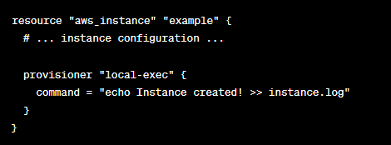
..
In this example, the local-exec provisioner runs the command echo Instance created! >> instance.log on the local machine after the aws_instance.example resource is created. It appends the message "Instance created!" to a log file called instance.log

Slide 7
Remote-exec Provisioner:
The remote-exec provisioner in Terraform allows you to execute commands or scripts on the remote machine after a resource is created. It connects to the resource via SSH (Linux) or WinRM (Windows) and runs the specified commands remotely.
The remote-exec provisioner is commonly used for remote configuration management, software installation, or any action that requires interaction with the created resource.

Slide 8
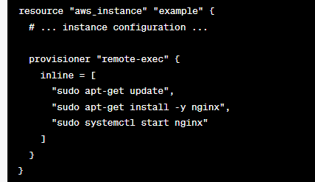
..
In this example, the remote-exec provisioner uses the inline parameter to execute a series of commands on the remote AWS instance. It updates the package lists, installs Nginx, and starts the Nginx service.

Slide 9
File Provisioner
The file provisioner in Terraform allows you to copy files or directories from the local machine to the remote resource after it is created. It ensures that required files are available on the target machine, enabling you to transfer configuration files, scripts, or any other necessary files during resource creation.
When using the file provisioner, Terraform establishes a connection to the remote machine using SSH (Linux) or WinRM (Windows) and securely transfers the specified files or directories to the remote resource.

Slide 10
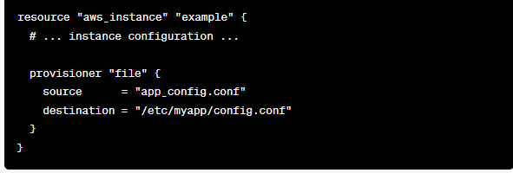
..
In this example, the file provisioner copies the app_config.conf file from the local machine to the remote AWS instance. The file is placed in the /etc/myapp/config.conf path on the remote resource.

Slide 11



